Slide 1

SecureAgent VTL and Customer Experience
Share - Boston
By
John Sawyer & John Waldron
SecureAgent Hastings Mutual
August 12, 2013

Slide 2

Agenda
Who is SecureAgent?
SecureAgent Customers
SecureAgent VTL & Differentiators
One Button Recovery
Hastings Mutual Insurance Company
Customer Experience
Notes:
2

Slide 3

Who is SecureAgent?
SecureAgent products and VTL enjoy patent protections in the US and Europe. It’s not just another VTL.
It’s a Managed Recovery Suite that uses VTL(s) with HDS disk to provide:
  Privately Held
  More than 25 years experience in the Industry
  Offices in Zurich, Stuttgart, New York, Tulsa, and FL.
  Test Facilities in Oklahoma, Pennsylvania, and Zurich
  Fortune 500 Customer Base
  Tape Replacement
  VTL Replacement & Migration
  Multi-Platform Support
  FIPS Compliant Security
  Remote Business Continuity & Disaster Recovery Tools
  One Button Recovery
Notes:
3
We’ll talk a little bit about our company, and then we’ll spend the majority of our time discussing the Secure Data Solution
We want to talk about the benefits … how it can be used and what systems you can use it for. We’ll talk about different configurations, some for Archiving, some for DR and some for Recovery situations … We’ll go over some of the architectural components…. Some of the features, and we’ll end up talking about how we can begin implementing a solution in your environment.

Slide 4







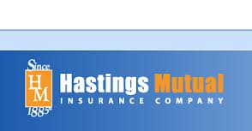
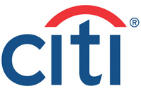





Hitachi and SecureAgent Joint Customers
GRZ

Slide 5
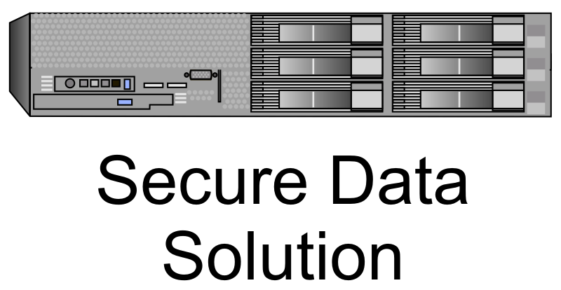
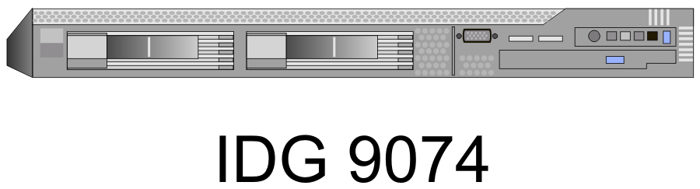
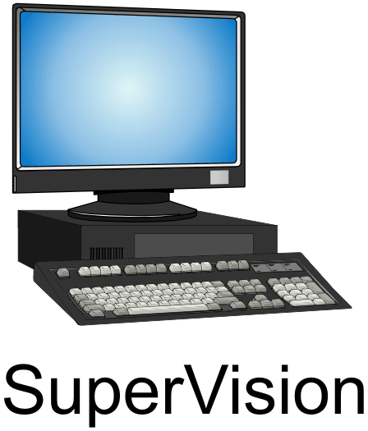
Three Integrated Tools, Adding Value!
VTL and Offsite Disaster Recovery
Provides All-in-One, Multi - System VTL for Mainframe, iSeries and Open Systems
HDS SecureAgent VTL
Emulated Encrypted Gateway
Provides Remote Encrypted Mainframe, iSeries, and Open System Connectivity for DR
IDG 9074
Automated One Button Recovery
Automates One-Button Remote Recovery of Mainframe, iSeries, and Open Systems
SuperVision
Notes:
Graphics need to be made transparent

Slide 6
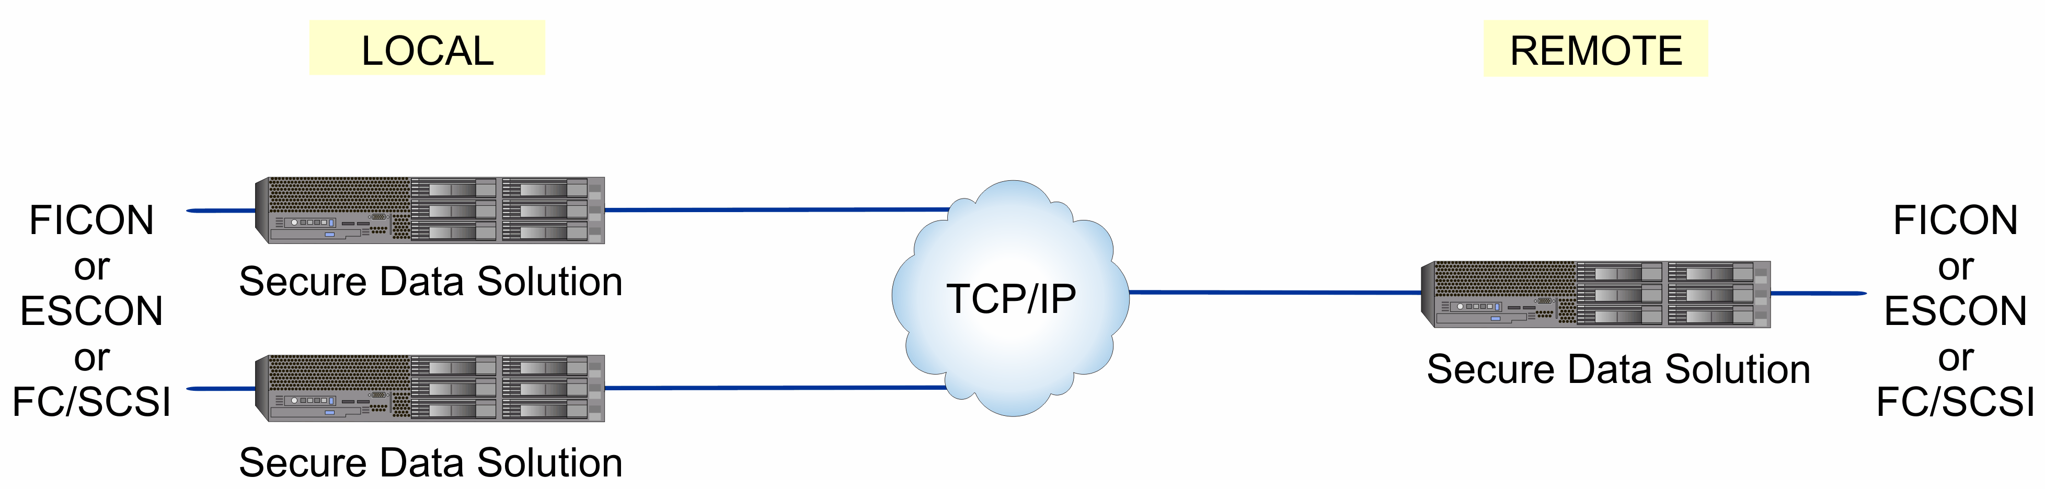
Scalable Solution for Everyone!

Slide 7


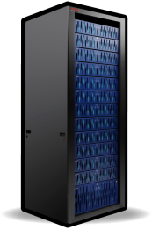
200 Terabyte VTL with Remote DR
200 Terabyte VTL with Remote DR
Production Site
Disaster Recovery Site
SecureAgent Catalog
SecureAgent Catalog
SecureAgent Channel Emulation
FICON
SecureAgent Channel Emulation
FICON
FC/SCSI
SecureAgent Storage
Interface
FC/SCSI
SecureAgent Storage
Interface
AMS
USP V
HUS
VSP
AMS
USP V
HUS
VSP

Slide 8



Scalable up to Multi – Petabytes
Ficon and
FC/SCSI
FC/SCSI
SecureAgent Catalog
Ficon and
20
20
SecureAgent Channel Emulation
SecureAgent Channel Emulation
Switch
Switch
20
20
8
SecureAgent Storage
Interface
SecureAgent Storage
Interface
8
8
SecureAgent Tape
Interface
SecureAgent Tape
Interface

Slide 9
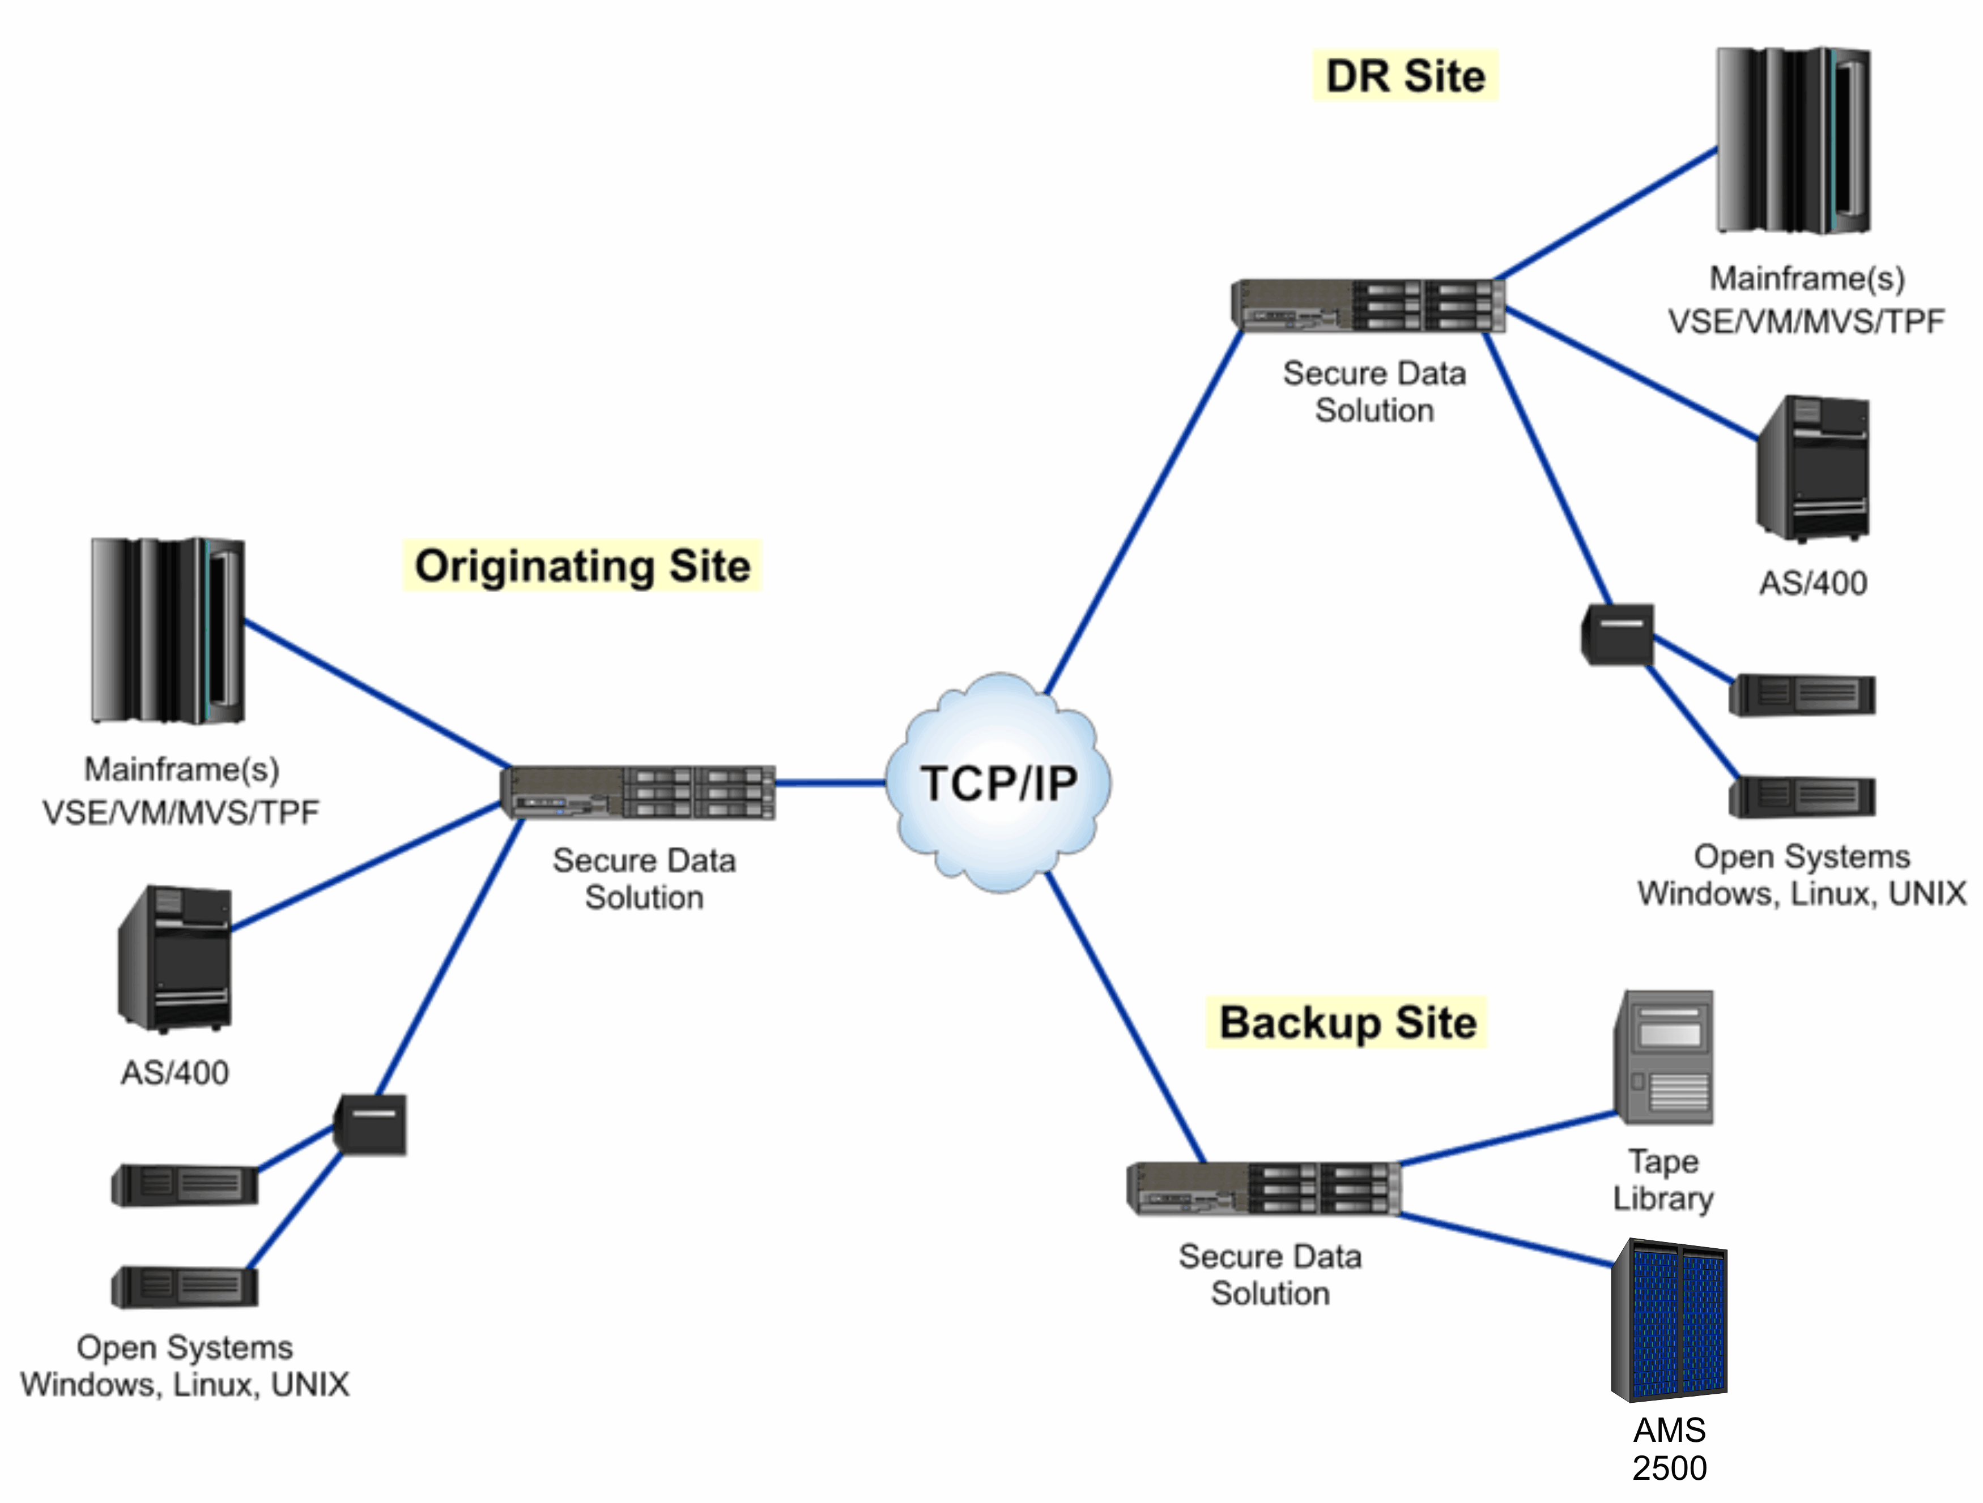
Integrated Multi-Site Recovery VTLs
DR Site
Original Site
Backup Site
AMS, HUS, USPV, VSP

Slide 10
Differentiators - Multi-Platform VTL
Production Site
Disaster Recovery Site
SecureAgent Catalog
SecureAgent Catalog
FICON &
FC/SCSI
SecureAgent Channel Emulation
FICON & FC/SCSI
SecureAgent Channel Emulation
FC/SCSI
SecureAgent Storage
Interface
FC/SCSI
SecureAgent Storage
Interface
AMS
USP V
HUS
VSP
AMS
USP V
HUS
VSP
Mainframe
UNIX
LINUX
iSeries
Windows
Backup Exec
Net Backup
TSM
SecureAgent
Channel Emulation
Notes:
(Click the pointer and then mention something like this)
“Now allow these stars to direct your attention back to the SecureAgent Channel Emulation Units”
(Click to bring up all the Hosts)
“SecureAgent Channel Emulation Units can connect to any Host….”

Slide 11

Differentiators – FIPS Security
and Encryption!
Does Your Company Allow Data To Be Stored Or Transferred Unencrypted???
ENCRYPTION!
It’s NOT Enough To Offer Only Compression.
Large Companies Today Demand Encryption
At All Points, in motion and at rest.
More And More Companies Require Multiple
Encryption Keys To Protect Different Types Of Data
Large US Banks Are Now Requesting Unique
Encryption Keys For Each and Every VOLSER

Slide 12
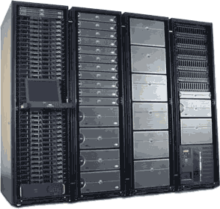

Differentiators – Total Distribution of Functionality
Redundancy
Unplug Any component with no production
impact
Problems in One Area of Functionality WILL NOT Affect Other Units
Upgrade and Scale with no downtime
Reduction of Production Downtime

Slide 13
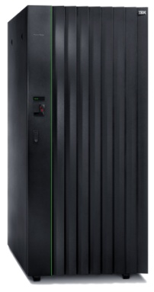
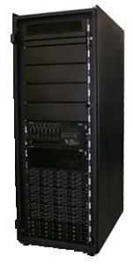
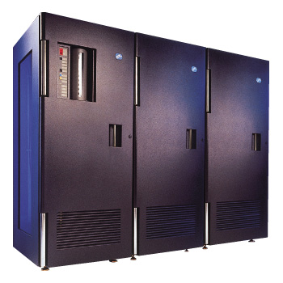
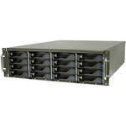
Differentiators – Supports Mainframe
& Open System Tape
Current Environment
Migration Environment
VTL Library-ID = 12345
FICON
FC/SCSI
FC/SCSI
FICON
34xx
35xx
Library-ID = 12345
Bxx
TS 77xx
SecureAgent Channel Emulation
FICON
SecureAgent Storage
Interface
SecureAgent Tape
Interface

Slide 14


Differentiators – Integrated Alerting
Remote Alerting
Automatically Alerts ops with WTO Msgs.
Integrated Alerts Through SuperVision DR
Integration with Alert Monitors via SNMP

Slide 15
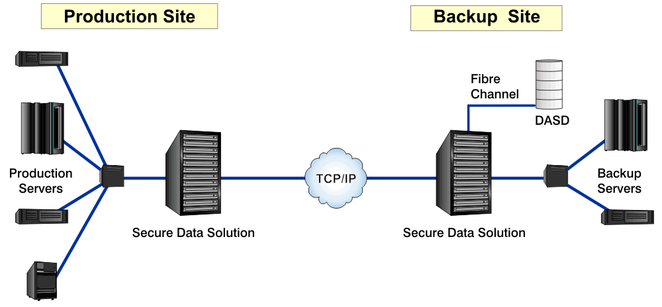

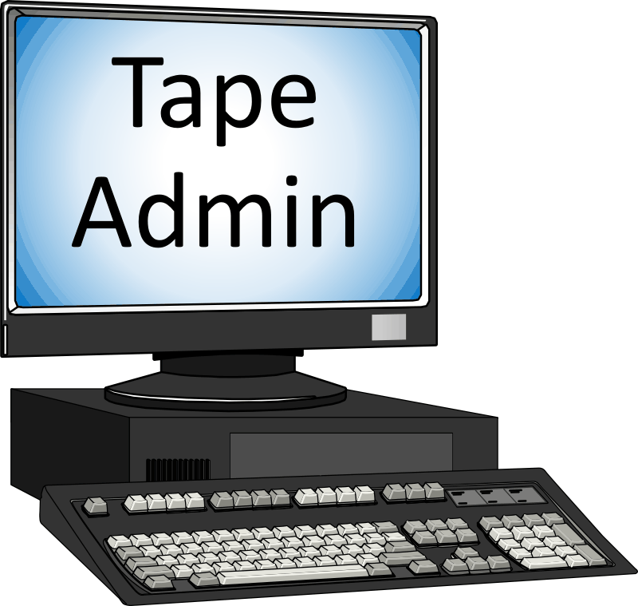
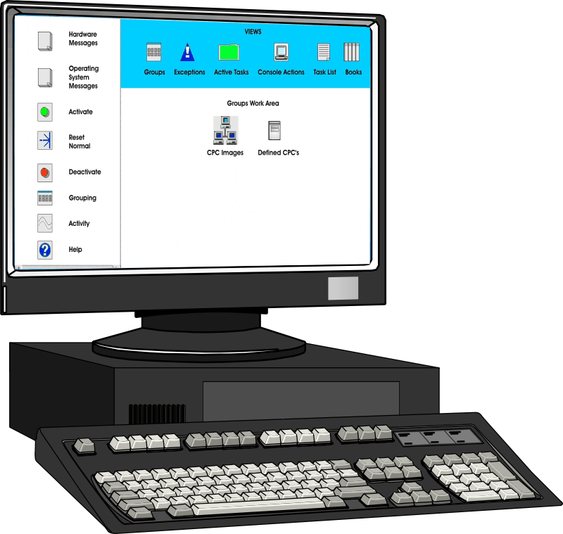
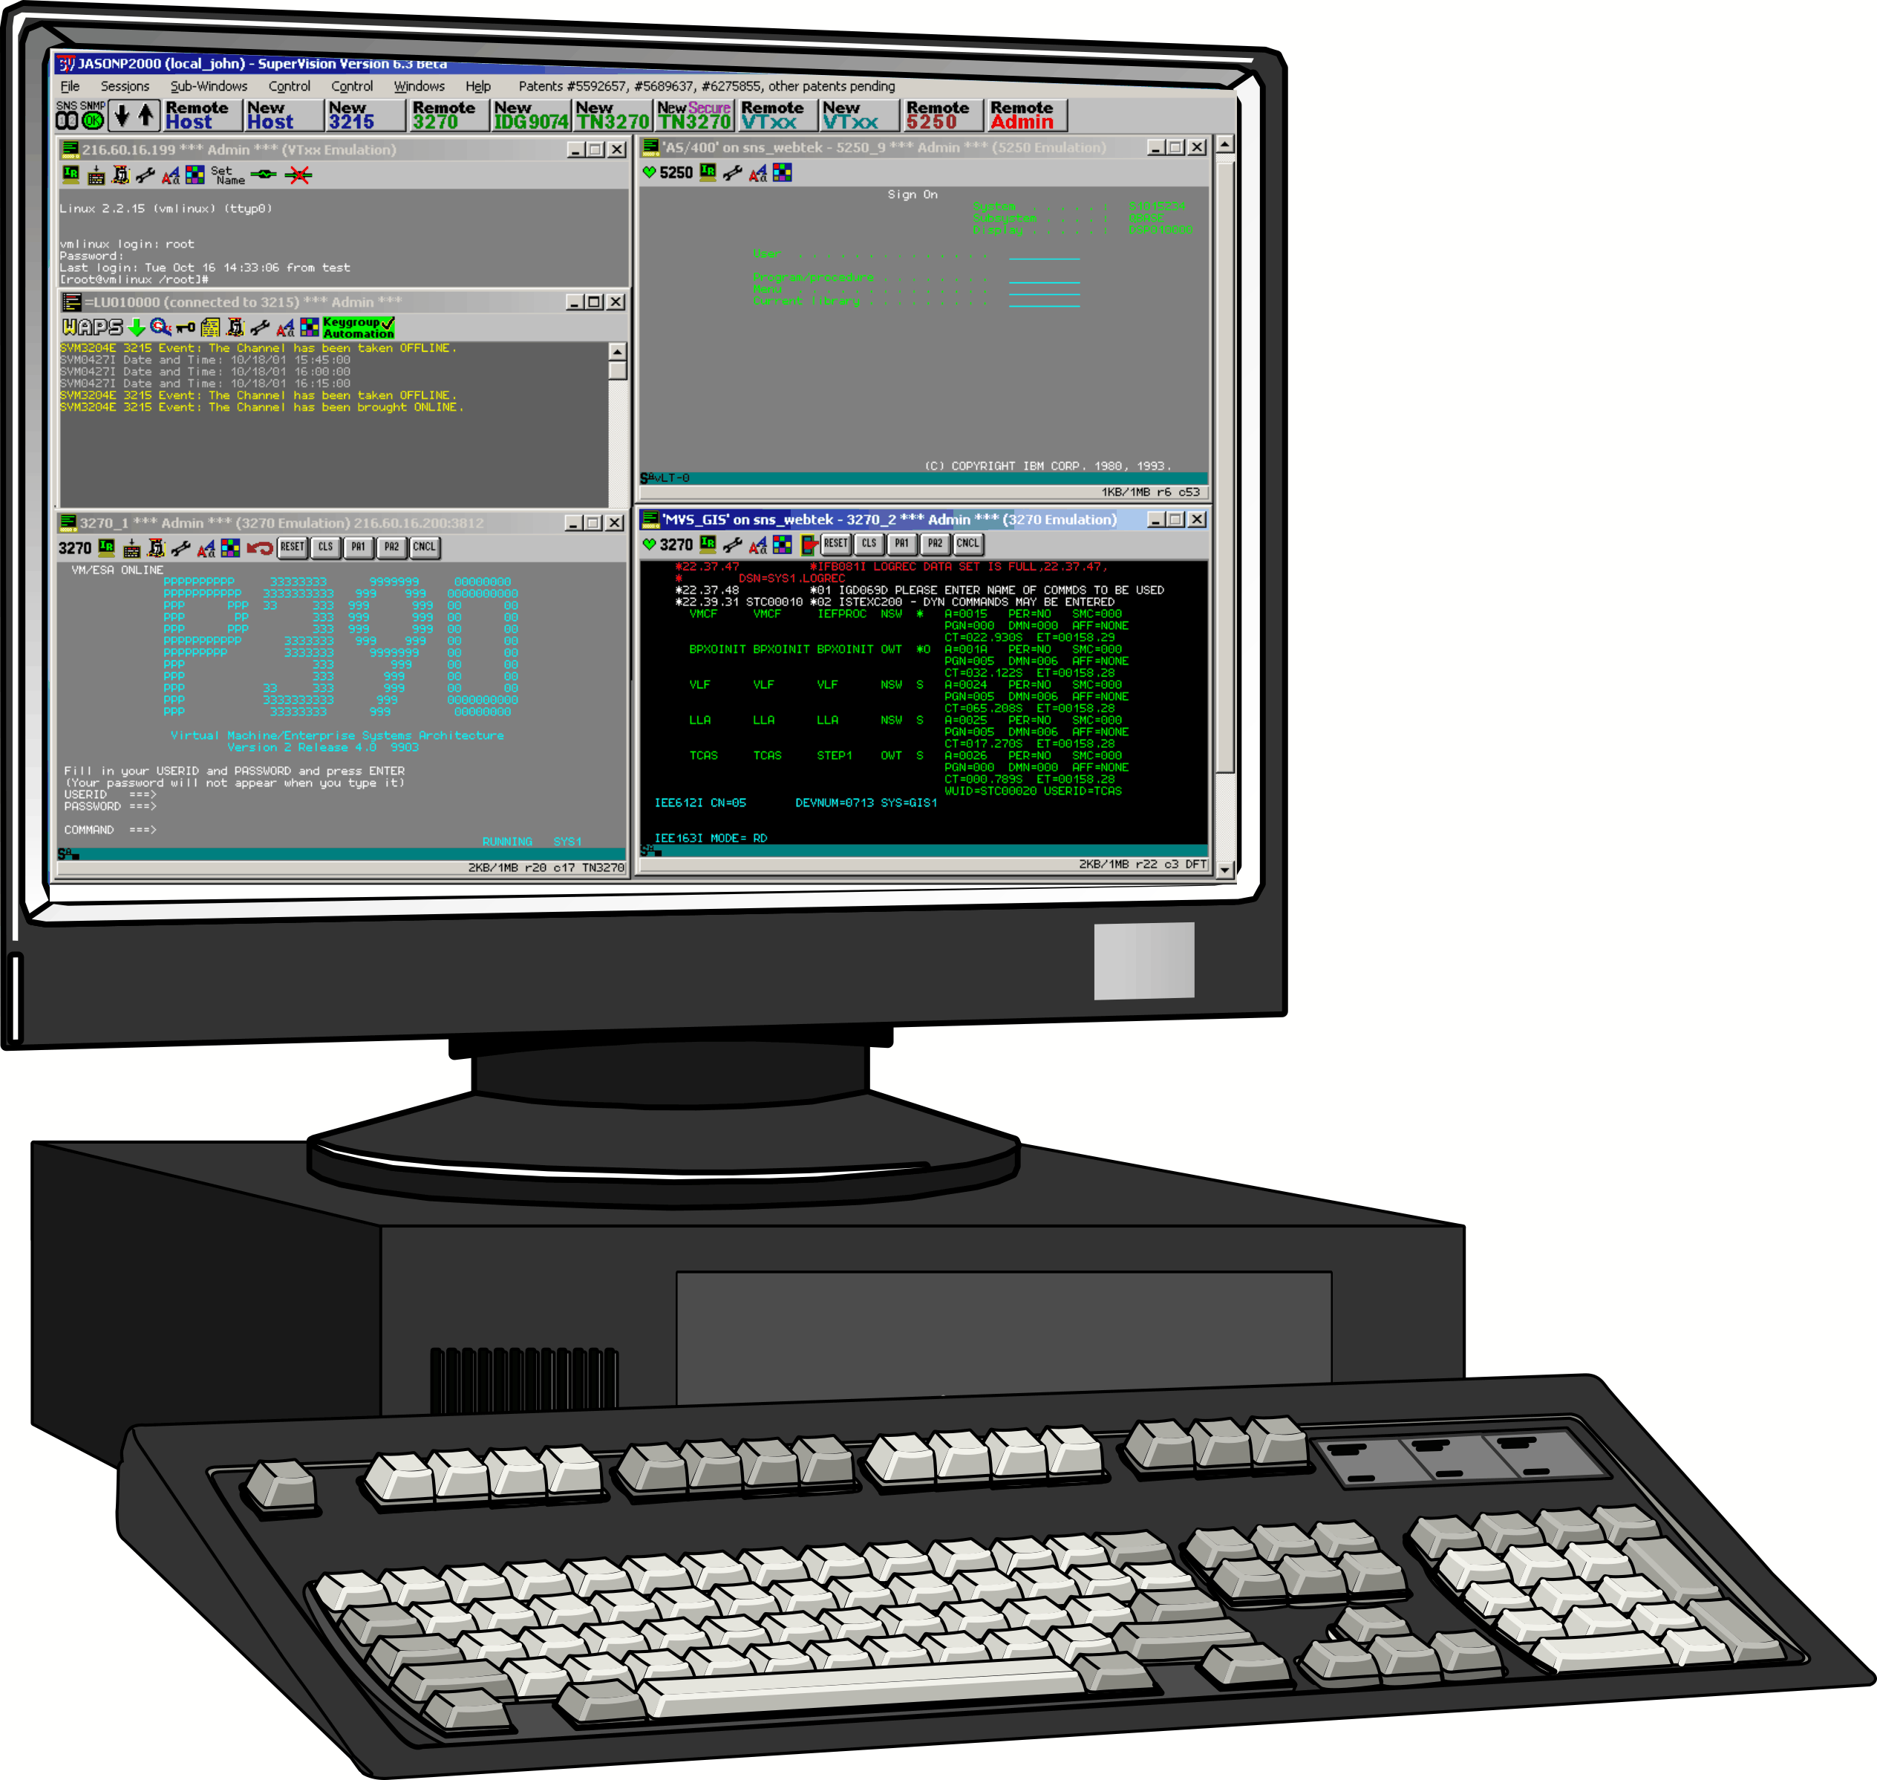
Differentiators - One Button Recovery
Integrated Console Tools and Virtual Tape – A Powerful Combination
1. Remote Tape Process Management
2. Remote Hardware & System Console Access
3. Integrated Automation
Tape Admin
HMC
MCS
6

Slide 16

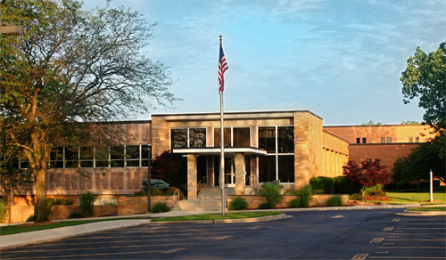
Hastings Mutual Insurance
Hardware Enhancements

Slide 17

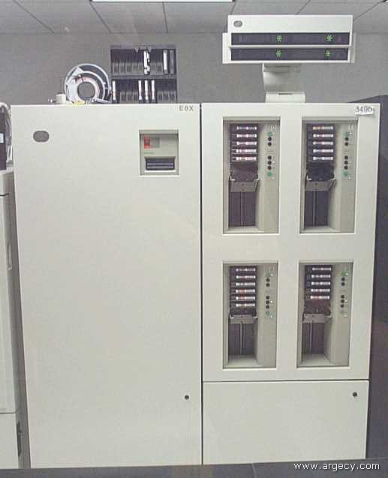
First Challenge:
Upgrade the Current Tape System

Slide 18
Background
HMIC’s backup system consisted of a StorageTek 9740 Library Storage Module and Hitachi 7490E cartridge module tape unit. Tape-based backup systems were beginning to be unreliable and restores/retrievals were impacting productivity. As HMIC grew and data storage increased, tape operations started to become more complex and costly to maintain.
HMIC’s existing business continuation procedure required shipment of tapes from Iron Mountain to our business continuation site with a potential to lose 24 hours worth of data .
Current Tape backup processes had increased to the point where we were not meeting our maintenance windows.

Slide 19
Considerations
To maintain continuous business operations, address regulatory requirements and archive business records, HMIC will need an infrastructure that can manage data from online application storage to offline, with permanent archive media.

Slide 20
Objectives
  Eliminate resources required to mount and un-mount physical tapes
  Eliminate annual supply costs of tapes
  Reduce annual maintenance costs
  Reduce Power consumption costs
  Eliminate cost associated with transportation and storage of Tape Library
  Increase program execution times to stored data

Slide 21
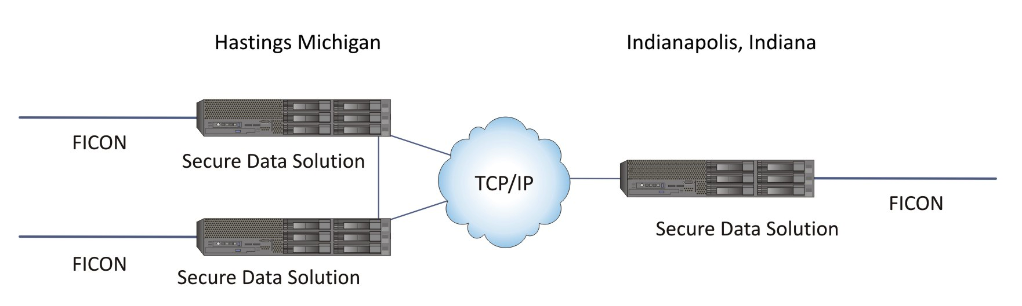
Virtual Tape Library
The Solution from SecureAgent
Through the use of virtualization and disk cache, the VTL solution is able to operate at disk speeds while maintaining compatibility with existing tape operations increasing productivity and eliminate manual intervention. Many of the VTL configurations completely eliminate physical tape through the use of deep disk cache repositories.

Slide 22
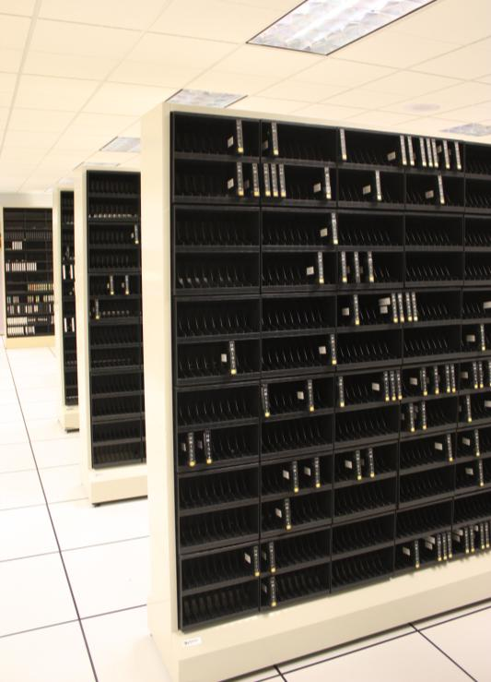
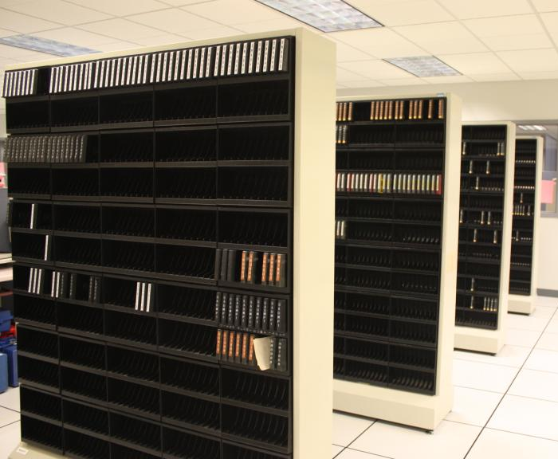
Realized Benefits
Elimination of mountains of tapes
  Over 2600 Tapes eliminated

Slide 23
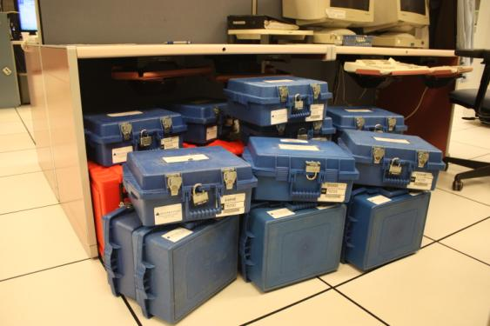
Elimination of tape rotations and pickup schedules for Iron Mountain.
  Reducing costs for these services by over $20,000.00 a year.

Slide 24
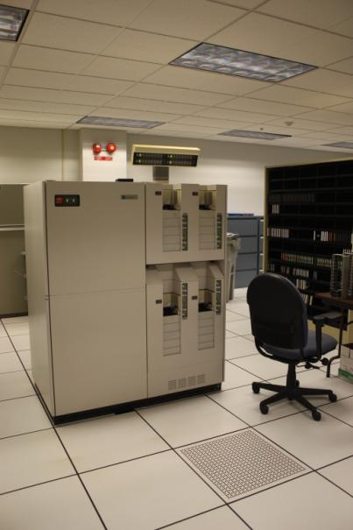
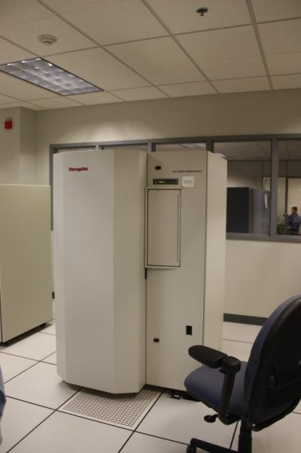
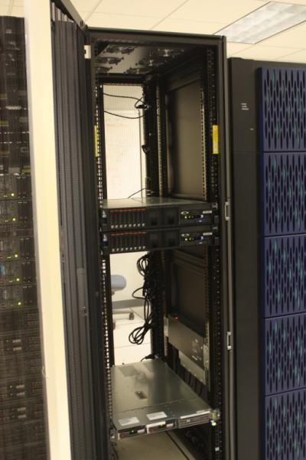
Reduced Foot Print of Hardware.
  Two units supporting the VTL system taking up 4U’s in a 19 inch cabinet replaced 2 Refrigerator sized units taking up 32 Square feet of floor space.
Older Conventional Hardware
New Hardware Technology

Slide 25

Elimination of Manual Processes
  Daily Tape Mounts on the two conventional Tape units Averaged 114 of which 32 required Manual intervention.
  48.9% were scratch mounts (Temporary Data)
  Eliminated 1 FTE Hour daily of Manual Intervention
  Eliminated 5 ½ FTE Hours for Saturday Backups

Slide 26
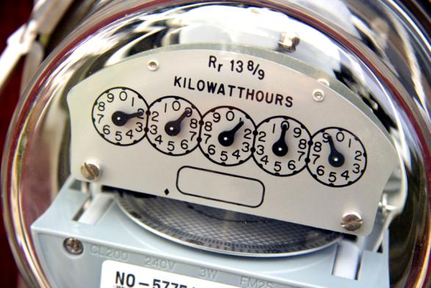
Power Consumption Reduction
  3 Conventional Units running on 240 Volt 50 Amp circuits, Versus 2 VTL units running on 120 Volt 20 Amp circuits .
  Power consumption reduced yearly by over $3,000.00.

Slide 27
Improved Backup and Restore Times
  Test Volume backups to the VTL solution were performed, capturing transfer and replication speeds for analysis, showing a decrease in time to backup by nearly 300%.
  In this test, conventional tape backups took 4 hours and 3 Minutes while VTL backups took 1 hour 15 minutes.

Slide 28
Total Benefits of using the VTL from Secure Agent
Tangible Benefits:
  Annual maintenance costs reduced $ 9,522.24 (yearly)
  Tape costs eliminated $ 969.90 (yearly)
  Power consumption reduced $ 3,036.00 (yearly)
  Operator man-hours reduced $14,040.00 (yearly average)
  Iron Mountain costs eliminated $ 21,000.00 (yearly average)
  Total average yearly savings $48568.14
Intangible Benefits:
  Ease of getting Disaster Recovery site ready for actual use/testing
  File recovery made easier and faster
  Elimination of Manual tape mounts

Slide 29
For more information please visit:
www.SecureAgent.com
or contact:
John Sawyer
Office: (918) 971-1600 or Cell: (918) 691-9000
Or john.sawyer@mail.SecureAgent.com
For Documentation:
http://www.secureagent.com/customerdownloads/
UserID: secureagent Password: tracy
Then click on Miscellaneous Tab for SDS Documents

